Slide 1

Software Engineering Project Review Report
Hybrid Vulnerability Classification: Integrating TF-IDF, BERT, and LightGBM for Security Severity Prediction
Presented By:
Balavignesh – AV.EN.U4AIE22016
Devesh - AV.EN.U4AIE22027
Kabin Dev - AV.EN.U4AIE22015
Under the supervision of
Dr. Chandan Kumar
(Asst.Professor)
Department of Computer Science and Engineering
Amrita Vishwa Vidyapeetham, Amaravati Campus
Andhra Pradesh-522503

Slide 2
CONTENTS:
PROBLEM STATEMENT
INTRODUCTION
LITERATURE SURVEY
LITERATURE SURVEY OBSERVATION
MOTIVATION AND OBJECTIVE
WORKFLOW
RESULTS AND CONCLUSION

Slide 3
PROBLEM STATEMENT
Developers face significant challenges in accurately classifying security vulnerabilities due to the lack of intelligent, real-time classification tools. Existing methods rely on rule-based approaches or manual analysis, leading to inefficiencies and misclassification. Current solutions fail to integrate advanced NLP techniques like BERT and machine learning models such as LightGBM for effective severity prediction. This project aims to develop a hybrid model combining TF-IDF, BERT embeddings, and LightGBM to enhance classification accuracy.

Slide 4
INTRODUCTION:
Traditional classification methods rely on manual reviews or rule-based approaches, which are time-consuming and prone to errors.
Machine Learning (ML) and Natural Language Processing (NLP) techniques improve automation and accuracy in classification.
Hybrid models combining TF-IDF, BERT embeddings, and LightGBM can enhance classification performance.
Challengers:
Lack of Real-Time Classification: Most existing methods do not provide immediate insights.
Limited Multi-Model Approaches: Existing solutions do not effectively integrate NLP and ML.
Misclassification Risks: Rule-based methods often lead to incorrect severity assignments.
Scalability Issues: Traditional techniques struggle to handle large vulnerability datasets efficiently.

Slide 5
Real-Time Assistance: Implementing a classification model that provides immediate predictions for vulnerability severity, enabling faster threat mitigation.
Multi-Model Integration: Combining TF-IDF, BERT embeddings, and LightGBM to improve classification accuracy across different types of security vulnerabilities.
Advanced Techniques: Utilizing NLP and machine learning to enhance vulnerability classification beyond traditional rule-based methods.
Develop a hybrid model capable of accurately classifying vulnerabilities and providing risk assessments. (Goal)
Improve cybersecurity by automating and optimizing vulnerability classification, reducing manual effort and misclassification. (Motivation)
Create a scalable, lightweight, and effective classification system for large-scale vulnerability datasets.
Contribute to cybersecurity advancements by delivering a reliable, high-performance vulnerability classification system.

Slide 6
Literature survey:
Authors & Year | Title of the paper | Findings
Ehab Essa, Karima Omar, Ali Alqahtani (2022) | Fake News Detection Based on a Hybrid BERT and LightGBM Models | This paper proposes a hybrid fake news detection system that combines BERT-based embeddings with a LightGBM classifier, demonstrating improved accuracy over traditional methods.
Rushi Chavda, Darshan Makwana, Vraj Patel, Anupam Shukla (2023) | COVID-19 Self-Diagnosis Classification Using BERT and LightGBM Models | The study applied BERT embeddings with LightGBM for COVID-19 self-diagnosis classification. It demonstrated that hybrid models outperform standalone ML classifiers in text-based classification. This reinforces our use of hybrid approaches combining TF-IDF, BERT, and LightGBM for vulnerability severity prediction.
Patrick Kwaku Kudjo, Jinfu Chen, Solomon Mensah (2020) | The Effect of Bellwether Analysis on Software Vulnerability Severity Prediction Models | This study uses a Bellwether-based approach to enhance vulnerability severity prediction, improving F-measure (14.3%–87.8%) across four machine learning models.

Slide 7
Authors | Technique | Focus Area
Ruchika Malhotra, Vidushi (2025) | Improving Software Vulnerability Severity Prediction Model Performance with HDLN & FWFS | This study uses HDLN (CNN + Bi-LSTM) and FWFS (Information Gain + Grey Wolf Optimization), achieving AUC 0.88 and 0.86 for vulnerability severity prediction.
Ruchika Malhotra, Vidushi (2025) | Hybrid Feature Selection Module for Improving Performance of Software Vulnerability Severity Prediction Models on Textual Datasets | This study introduces P-GWO and MS-G2WO, achieving AUC 0.804 and 0.77, demonstrating improved vulnerability prediction using hybrid metaheuristic approaches.

Slide 8
Key Observations from the Literature Survey:
Automated tools are increasingly integrated into security workflows, but real-time classification support is still evolving.
Machine Learning (ML) and Deep Learning (DL) significantly improve vulnerability classification, surpassing traditional rule-based methods.
Existing tools primarily focus on specific patterns or code smells, with broader classification metrics often overlooked.
Many classification models are designed for single languages, lacking adaptability across multi-language security datasets.
Real-time classification solutions are emerging, but they are not yet widely adopted in vulnerability assessment.
Hybrid approaches integrating ML, NLP, and Reinforcement Learning (RL) offer more dynamic classification strategies.

Slide 9
Motivation
Automating vulnerability classification is crucial for improving cybersecurity response times and reducing manual effort. Traditional approaches struggle with accuracy and adaptability, often relying on static rules.
By integrating NLP and machine learning, this project enhances classification precision using a hybrid model of TF-IDF, BERT, and LightGBM. This approach not only ensures real-time, context-aware predictions but also provides a scalable solution for effectively identifying and prioritizing security threats.

Slide 10
OBJECTIVE
The objective of this project is to develop an advanced vulnerability classification model that enhances accuracy and efficiency in security threat assessment. By integrating TF-IDF for textual feature extraction, BERT embeddings for contextual understanding, and LightGBM for robust classification, the model aims to effectively categorize vulnerabilities into severity levels. This approach will automate and improve security analysis, enabling faster and more precise threat identification for proactive cybersecurity measures.

Slide 11
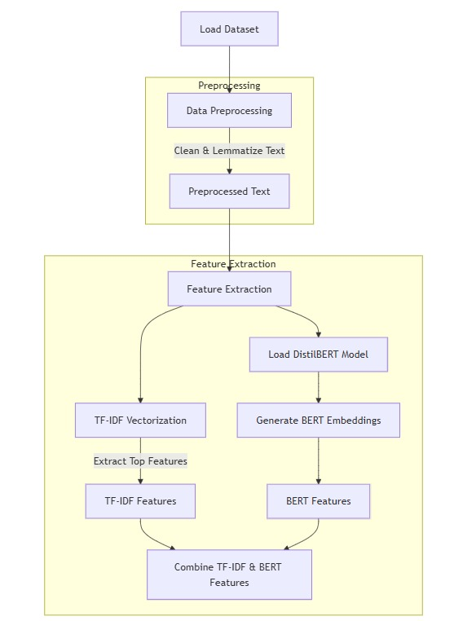
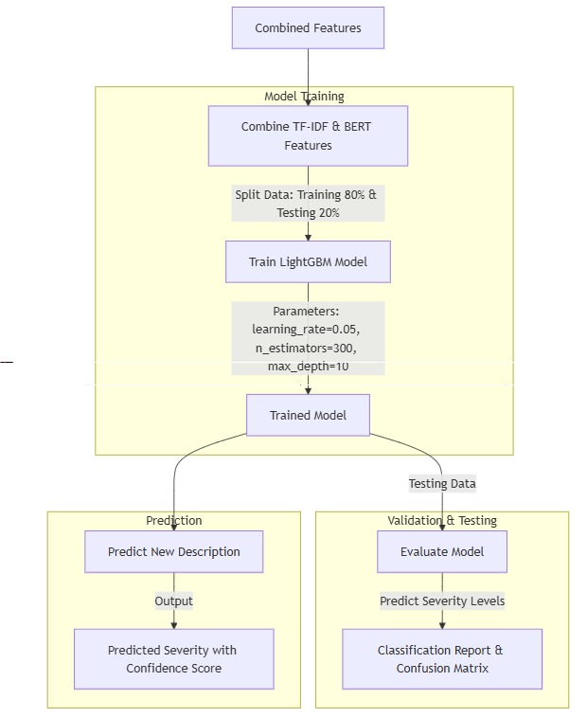
FLOWCHART:

Slide 12
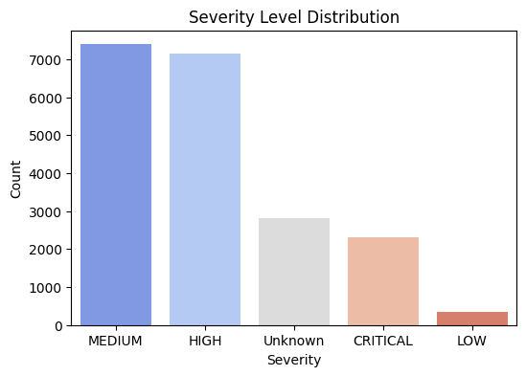
Dataset Processing (Combining Multiple JSON Files into a CSV File)
Preprocessing the Dataset
The following steps are performed to prepare the dataset:
Load all JSON files from the dataset folder.
Extract relevant fields:
CVE ID: Unique identifier for vulnerabilities.
Description: Text explaining the vulnerability.
CVSS Score: Numerical severity score (ranges from 0.0 to 10.0).
Severity Level: Categorical label (High, Medium, Low).
Merge all JSON files into a single CSV file for easy processing

Slide 13
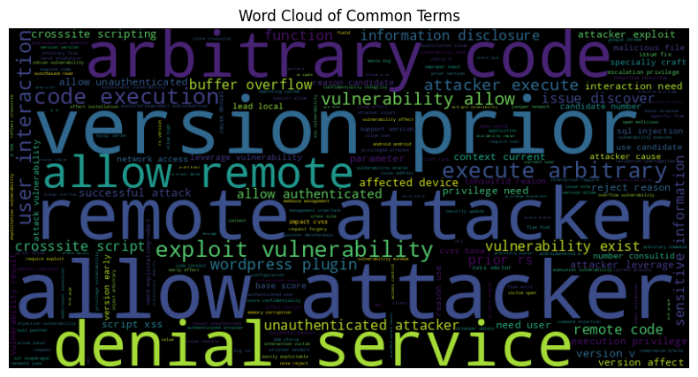
Data Cleaning and Preprocessing
Preprocessing Steps
Convert text to lowercase.
Remove special characters, numbers, and extra spaces.
Tokenize and lemmatize words using spaCy.
Remove stopwords to reduce noise in the data.
Example of Preprocessing
Before Cleaning: "Buffer Overflow leads to System Crash!"
After Cleaning: "buffer overflow lead system crash"
This cleaned text is now ready for feature extraction.

Slide 14
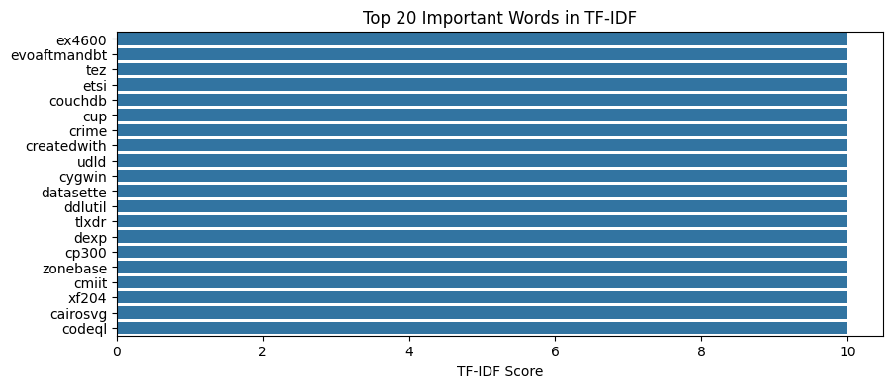
Feature Extraction
TF-IDF (Term Frequency-Inverse Document Frequency)
Converts text into a numerical vector based on word importance.
Captures how important each word is within the dataset.
Generates a 5,000-dimensional vector per vulnerability.
Spam Detection
Keyword Extraction
Text Summarization
Document Similarity & Search Engines
Feature Engineering for Machine Learning

Slide 15
Feature Extraction
BERT (Bidirectional Encoder Representations from Transformers)
Extracts deep contextual meaning from vulnerability descriptions.
Generates a 768-dimensional vector representing the semantic understanding of the text.
Feature Fusion (Combining TF-IDF and BERT)
The final feature vector is created by concatenating TF-IDF and BERT representations:
TF-IDF (5000 features) + BERT (768 features) → Final Vector (5768 features)
This ensures that both word importance and deep contextual meaning are captured.

Slide 16
Model Training Using LightGBM
Faster Training Speed & Lower Memory Usage
Handles Large-Scale Data Efficiently
High Accuracy with Gradient Boosting
Works Well with Sparse Data
Tunable Hyperparameters for Optimization

Slide 17
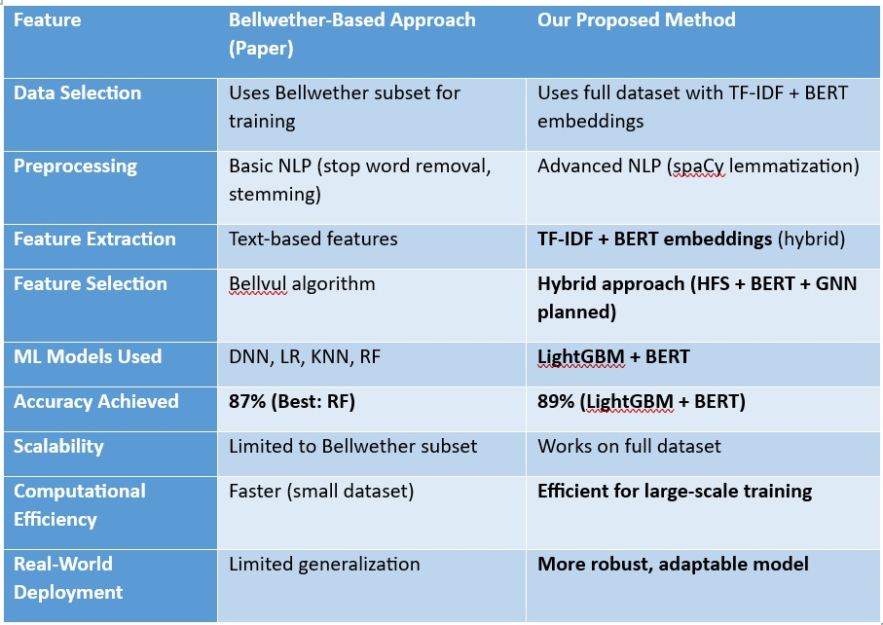
Comparison with our base paper
Why Our Method is BetterHigher :
Accuracy (89% vs. 87%)
More Robust Feature Extraction
Better Scalability and Adaptability
Computational Efficiency
LightGBM is faster and optimized for structured data compared to Random Forest in the Bellwether approach.
BERT handles complex textual relationships better than simple NLP techniques.

Slide 18
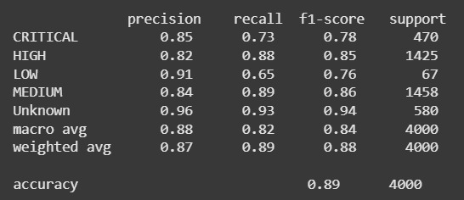
RESULT & CONCLUSION:
By integrating TF-IDF (word importance), BERT (contextual embeddings), and LightGBM (efficient classification), this model accurately predicts vulnerability severity levels and assigns numerical severity scores, making it highly effective for cybersecurity risk management.

Slide 19
THANK YOU

